Slide 1
heuristic tips slides online (soon)

Slide 2
COMP 3020: Human-Computer Interaction I UCD: usability testing
Fall 2013
James Young, with acknowledgements to Anthony Tang, Andrea Bunt, Pourang Irani, Julie Kientz, Saul Greenberg, Ehud Sharlin, Jake Wobbrock, Dave Hendry, Andy Ko, Jennifer Turns, & Mark Zachry

Slide 3
evaluation approaches
analytical
usability testing, experiments
field studies

Slide 4
usability test
A usability test is a “formal” method for evaluating whether a design is learnable, efficient, memorable, can reduce errors, meets users’ expectations, etc.
users are not being evaluated
the design is being evaluated
Notes:
This is an important point—that users are not the ones being evaluated. Although we recruit them, and ask them to complete tasks for us, and we watch them fail, the key is that what we are evaluating Is whether the design is making it something that they can do

Slide 5

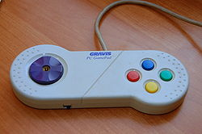
learnable, memorable, but inefficient
Notes:
Easy to learn, but less task coverage (and perhaps inefficient)

Slide 6

difficult to learn, but efficient
mouse left
mouse right
W
A
D
S
Notes:
Difficult to learn, but efficient

Slide 7
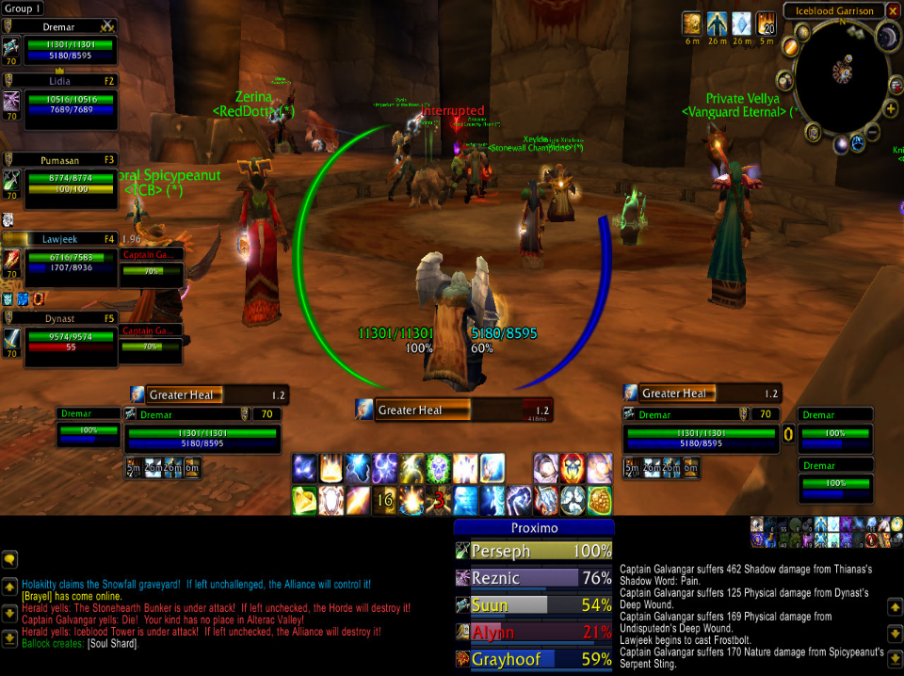
difficult to learn, efficient? reduces errors? satisfaction?
Notes:
Crazy to look at, difficult to learn, but efficient
so – we have competing goals

Slide 8
main goals of evaluation
assess extent and accessibility of system’s functionality
does it meet requirements?
can people perform tasks easily?
assess the user’s experience with the interaction
how “usable” is the system?
do people get frustrated, or do they enjoy the system?
identify any specific problems with the system
places where many people get confused?
aspects where people make a lot of mistakes?
do users make workarounds / crutches?

Slide 9
usability test – rough outline
bring in real users
have them complete tasks with your design, while you watch with your entire team
measure and record things
task completion, task time, error rates
satisfaction, problem points, etc.
use a think-aloud protocol, so you can “hear what they are thinking”
identify problems (major ones | minor ones)
provide design suggestions to design/engineering team
iterate on the design, repeat

Slide 10
required watching
Corel paper prototype test
http://www.youtube.com/watch?v=ppnRQD06ggY
What users actually do : http://www.youtube.com/watch?v=HAiJCPWMGss
Notes:
What is striking about this video?
Site settings -> use of terminology
Notions of mental models, and how design can push one or another
You can evaluate some things just with paper prototypes!
What are they evaluating here? (flow)
What can you not evaluate with a paper prototype?

Slide 11
designing an evaluation
evaluations can be very time-consuming and costly, requires extensive planning
which methods and techniques to employ requires careful consideration
point: PLAN AHEAD and THINK IT THROUGH

Slide 12
DECIDE: a framework to guide evaluation
Determine the goals the evaluation addresses
Explore the specific questions to be answered
Choose the evaluation method and techniques to answer the questions
Identify the practical issues
Decide how to deal with the ethical issues
Evaluate, interpret and present the data

Slide 13
determine the goals (DECIDE)
what are the high-level goals of the evaluation?
refer back to usability goals and criteria
(performance, behavioral, etc.)
who wants the evaluation, and for what purpose? (sales, ease of use, etc.)
impacts methods used
some examples of goals:
identify the best metaphor on which to base the design
check to ensure that the final interface is consistent
compare effectiveness against competitors
improve the usability of an existing product

Slide 14
explore the questions (DECIDE)
goals & questions guide evaluations to keep focus
(deceptively hard!)
for example, the goal of finding out why many customers prefer airline check-in kiosks to agent check-in?
what are customers’ attitudes to kiosks?
is the interface good or poor?
how long does it take to check-in?
is this more efficient than checking-in with an agent?
how common are exception that need an agent’s help?

Slide 15
choose evaluation approach & techniques (DECIDE)
the goals and questions dictate techniques used, how data is analyzed and presented.
E.g. field studies do not involve testing or modelling
use IDEO methods!
combination of approaches and techniques is preferred
goal is to address the goals and questions!!
triangulation (e.g., unsure if method X will work)

Slide 16
approach and techniques
performance
task success, time on task, errors, efficiency
issue metrics
identify issue, issue severity
behavioural
observe verbal behaviour, issue severity, think aloud
self-reported
ease, satisfaction, clarity, comprehension, etc.
Notes:
These are things you can really drill down on, and consider carefully

Slide 17
selecting tasks
depends a lot on what you’re looking for
specific: does a task flow work?
broad: does your language match the user’s mental model/language?
consider “the context of use”
What would someone need to do with your tool?
Under what circumstances would they be in? (relaxed vs. under pressure; non-interrupted vs. interrupted constantly)
etc.

Slide 18
method validity…
reliability: can the study be replicated?
user testing → higher reliability
interviews → lower reliability
validity: is it measuring what you need?
e.g., measuring text entry with familiar words versus syntax
biases: where are biases in the methods?
semi-structured interviews – leading?
observations – only watching for what you want?
scope: can the findings be generalized beyond the study setup?
working under pressure
ecological validity: is the environment of the study influencing the results?
lab has low ecological validity, Hawthorne effect (being watched!)

Slide 19
CONCRETE plan
make a script (seriously)
step by step take on all the actions that you and the participant will do

Slide 20
identify practical issues (DECIDE)
carefully select users to ensure representative of user population
user profiles, personas!
stay on budget
stay on schedule
find evaluators (who helps you?)
select equipment

Slide 21
how many users?
Main argument: If you have 15 people, it’s better to test three designs with 5 users each, rather than one design with 15 people. ➔ Pragmatics, bang for buck
Notes:
Nielsen & Landaurer (1993)
http://heb.freeshell.org/ie662/lecture7small.pdf
Rationale: you learn almost right away what is working well and what isn’t. if the first three people can’t login, you’re probably better off fixing the login page, rather than testing another 12 people on it
Most usability tests will help show you obvious problems, and those are the ones you want to get rid of right away

Slide 22
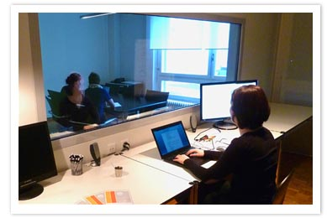
testing environments…
Notes:
http://lynnewatanabe.wordpress.com/2011/08/24/could-usability-testing-of-websites-help-non-profits-heck-yeah/
http://www.telono.com/en/lelab/fixed-lab
http://www.clockwork.net/blog/2009/11/04/291/our_usability_lab_keepin_it_simple
http://www.experiencelabstudios.com/studio_small.html

Slide 23
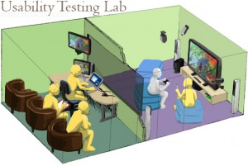
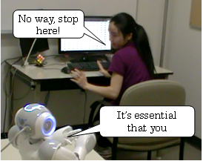
testing environments…
Notes:
http://lynnewatanabe.wordpress.com/2011/08/24/could-usability-testing-of-websites-help-non-profits-heck-yeah/

Slide 24

testing environments…
Notes:
http://lynnewatanabe.wordpress.com/2011/08/24/could-usability-testing-of-websites-help-non-profits-heck-yeah/

Slide 25

testing environments…
Notes:
http://lynnewatanabe.wordpress.com/2011/08/24/could-usability-testing-of-websites-help-non-profits-heck-yeah/

Slide 26

in the wild?

Slide 27
testing environments…
best environment depends on pragmatic considerations, as well as what you’re looking for
Do you want your whole team to be able to view?
Do you want to be able to review a test?
Are interruptions important?
Repeat use systems, or one-time use systems?
What are you resources?

Slide 28
pilot studies –trial runs of main study
make sure your plan is viable
all the corners are checked (your script, questionnaires, experiments, etc., all work)
that interview scripts, questionnaires, experiments, etc. work appropriately
it is worth doing several to iron out problems before doing the main study
ask colleagues if you can’t spare real users

Slide 29
decide on ethical issues (DECIDE)
participants have a right to:
know the goals of the study
know what will happen during the study
know what will happen to the findings
have their personal information keep private
not be quoted without their agreement
leave when they wish
be treated politely
Notes:
Milgram experiment

Slide 30
ethical issues
Develop an informed consent form
Should be the first thing the user agrees upon before any user testing begins
Sample:
The purpose of this evaluation is to study and measure users’ performance with a new prototype of a system under development. The process will involve performing a set of specific tasks, which will then be followed by a questionnaire containing a set of open-ended and close-ended questions. The information gathered will be used simply for improving the quality of our system. The data along with your name and identity will be kept confidential. You are free to ask questions or to withdraw from this study at any time without penalty.
I fully understand the needs of your research and I am willing to participate in your evaluation.
_______________ ______
Signature Date

Slide 31
ethics in testing: before the test
don’t waste their time
use pilot tests to debug experiments, questionnaires etc.
have everything ready before the user shows up
make users feel comfortable
emphasize that the system is being tested, not the user
acknowledge that the software might have problems
let users know they can stop at any time
maintain privacy
tell users that individual test results will be kept completely confidential
inform the user
explain any monitoring that is being used
answer all user’s questions (but avoid bias)
only use volunteers
user must voluntarily sign an informed consent form

Slide 32
ethics in testing: during the test
don’t waste the user’s time
never have the user perform unnecessary tasks
make users comfortable
try to give user an early success experience
relaxed atmosphere, give breaks
never indicate displeasure with performance
handout test tasks one at a time (don’t overwhelm them)
avoid disruptions
stop the test if it becomes too unpleasant
maintain privacy
do not allow the user’s management to observe the test

Slide 33
ethics in testing: after the test
make the user feel comfortable
state that the user has helped you find areas of improvement
inform the user
answer particular questions about the experiment that could have biased the results before
maintain privacy
never report results in a way that individual users can be identified
only show videotapes outside the research group with the user’s permission

Slide 34
evaluate, interpret & present data (DECIDE)
how data is analyzed & presented depends on the approach and techniques used
IDEO Learn methods!
statistics (are awesome)

Slide 35
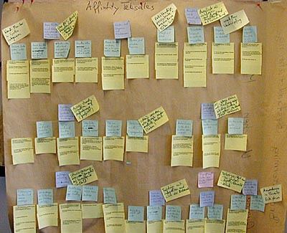
making sense of your data
affinity diagrams
Notes:
http://www.baran-systems.com/Products/Affinity%20Diagram%20for%20Excel/index_concept.htm
The main idea is to cluster ideas and observations so that you can make sense of what’s going on

Slide 36

making sense of your data
discussion with others who watched with you
Notes:
http://www.how-to-kiss.us/get-to-know-someone.html
Part of affinity diagramming.

Slide 37
data analysis
large volume of data, such as video, is daunting
important to plan data analysis carefully
“eyeball” the data to see what stands out
are there patterns or significant events?
is there obvious evidence that appears to answer a question or support a theory?
conduct a formal method to test your theory

Slide 38
data analysis
qualitative data
interpreted & used for telling a ‘story’ about what was observed
describe interaction patterns (literature of computing!) e.g., four ways that people may use the interface
(difficult!)
quantitative data
collected from interaction & video logs
presented as values, tables, charts, graphs and treated statistically
(safe!)

Slide 39
usability testing: present results
rank issues in terms of severity
not only a list of problems and issues!
provide small suggestions on how to address
size dependent on where you are in the design cycle
provide evidence (video, quotes, examples) of people encountering issues
ITERATE ON THE DESIGN!!?!?!?
sample final report:
http://www.utexas.edu/learn/usability/report.html
Notes:
http://www.utexas.edu/learn/usability/report.html

Slide 40
DECIDE: a framework to guide evaluation
Determine the goals the evaluation addresses
Explore the specific questions to be answered
Choose the evaluation method and techniques to answer the questions
Identify the practical issues
Decide how to deal with the ethical issues
Evaluate, interpret and present the data

Slide 42
not shown in class

Slide 43
Qualitative Analysis
Need to provide a convincing story about issues encountered during observations
Affinity diagramming
involves grouping actions, events, comments, etc. based on their similarity
Use the groupings to identify prominent themes
Other analysis techniques
Protocol analysis
Develop and apply a detailed coding scheme to think-aloud comments that gets at the meaning behind comments
Quantitative analysis of qualitative data
Workflow models
Look for common patterns in system use
Identify any “breakdowns”

